Slide 1


Thesis
Titanic Data Findings
IEEE
AI Team : Task 3
By : Abdelrahman Sameh
Loading The Data
First, we starting by loading the CSV file into the editor as a Pandas data frame.
After so, we take a quick look on the data to determine which fields got corrupted (NaN) values and how many of them to have an insight before we start data cleaning.

Slide 2
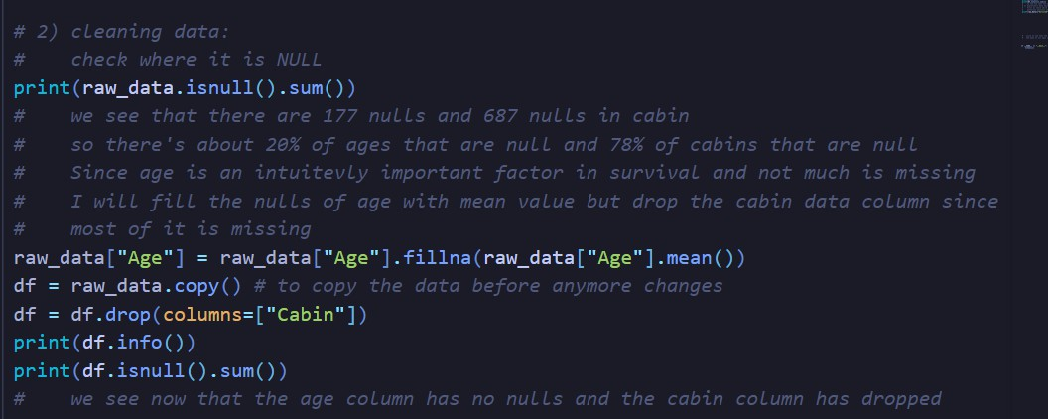
2
Data cleaning
After loading the data, we quickly notice that most of the data was intact except for the age and cabin columns which had the most amount of NaNs, with Age having about 20% of its fields being NaNs and Cabin having around 78% of its fields being NaNs.
Since its intuitive to think that age would be of great importance for survival and that its not as corrupted, I decided to fill the NaNs of age with the age mean value.
I also decided to drop the cabin column as its immensely corrupted and wouldnt be of use for the data.
We also made sure that the “Sex” column only had male or female for further analysis.
Exploratory Data Analysis (EDA)
We perform a couple of operations on data to get useful insights about the titanic and survivorship in general.
Relation between classes and survival rate
We notice that first class had a survival rate of 62% with 133 people surviving.
Second class had a survival rate of 44% with 82 people surviving.
Third class had a survival rate of 24% with 117 people surviving.

Slide 3
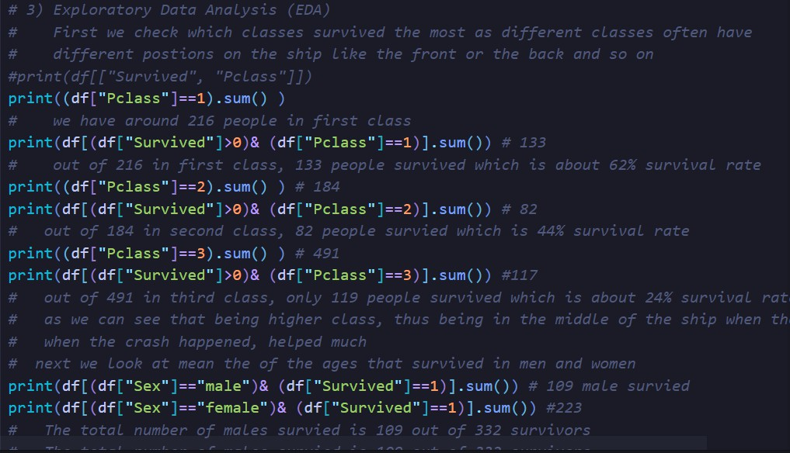
3
It appears that the position of cabins based on classes with first class in the middle of the ship to reduce motion and such helped with survival and less impact of the collision on people.
Relation between number of males and females
We notice that out of survivors, males made up only 33%, while females made up 67% of the survivors.
So its safe to assume that women cabins were in places that were more secure and afloat than men.
Relation between age of males and females
The mean age of men was 30.5.
The mean age of women was 30.5.
The mean age of men who survived was 27.6
The mean age of women who survied was 27.9.

Slide 4
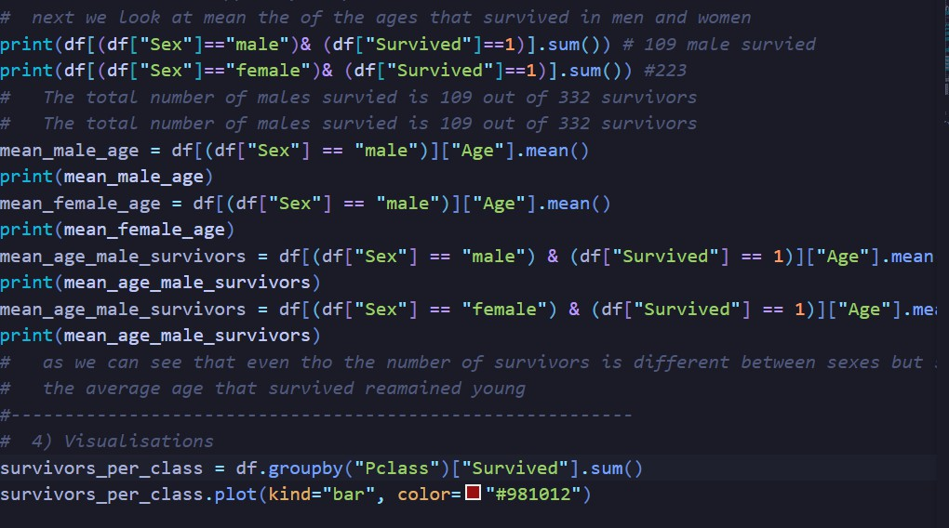
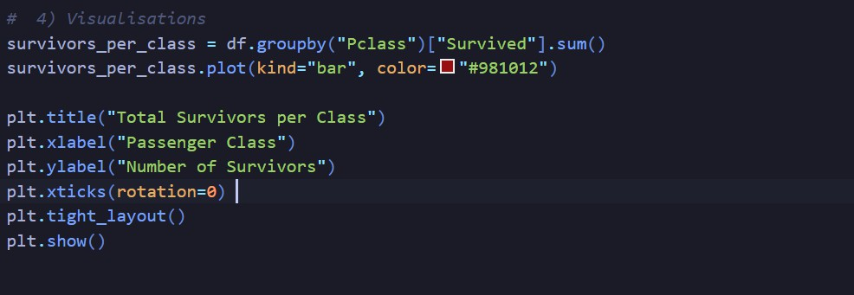
4
Visualisations

Slide 5
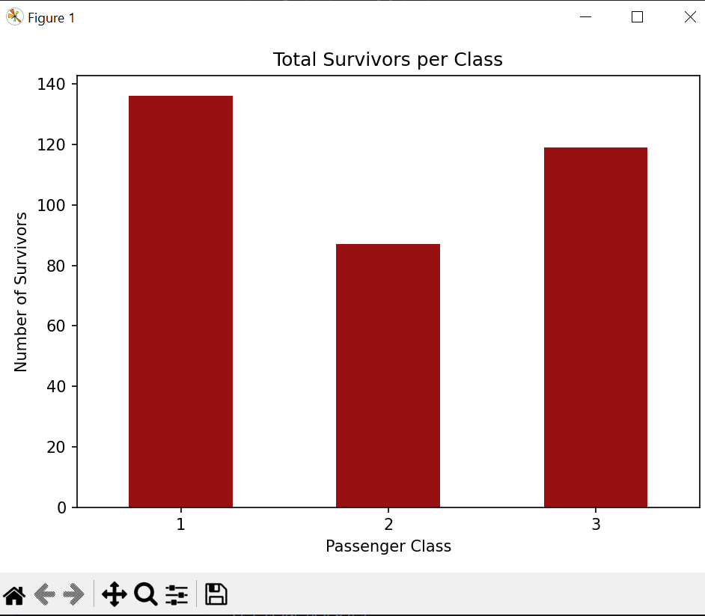
5

